Slide 1
Another Delay?! Using KNN to predict departure times
Akshar Shrivats
IB Computer Science HL 4B

Slide 2
The Data
Extremely Large
3 individual files
31 total factors
Published by the DOT
Fairly recent
Notes:
My data was collected from Kaggle and titled 2015 Flight Delays and Cancellations. The U.S. Department of Transportation's (DOT) Bureau of Transportation Statistics tracks the on-time performance of domestic flights operated by large air carriers. Summary information on the number of on-time, delayed, canceled, and diverted flights is published in DOT's monthly Air Travel Consumer Report and in this dataset of 2015 flight delays and cancellations. As I came to find out, the vast amount of data was unwieldy, difficult to test with, and hard to train models upon. At almost 1GB with more than 5 million records, I determined that I would only use 10,000 randomly selected lines from this dataset in my analysis. I chose this dataset because of it’s reputable source, wealth of factor information, and variety in geographic location, airline, and delay notification type.

Slide 3
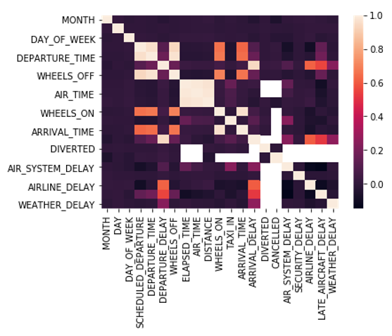
Data Visualization
A Correlation Plot to find trends visually
Notes:
This plot helped me identify trends when I began looking at the data and helped me determine what factors were most important and what I could easily get rid of
It plots each factor against each other factor and determines a factor of correlation between -1 and 1, where 1 means they have a direct connection
Here, I immediately got rid of information about the date, year, and day, along with flight number
I noticed that air_system_delay and arrival_delay had some orange and white spots throughout the graph

Slide 4
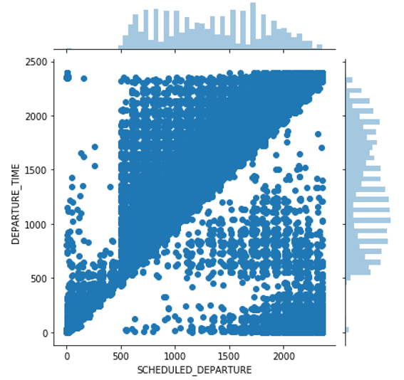
Data Visualization
A jointplot to see if my hypothesis was valid
Notes:
Using a data visualization library called seaborn, I plotted the scheduled departure time against the actual departure time to see if delayed flights were as prevalent as I thought they were
If all flights departed on time, the graph would look like a straight line – signifying a direct correlation
It became clear that delays were very common and some delays were very long
One thing I had to look out for in this graph was time looping back to 00:00 after 23:59 because of the 24hr format

Slide 5
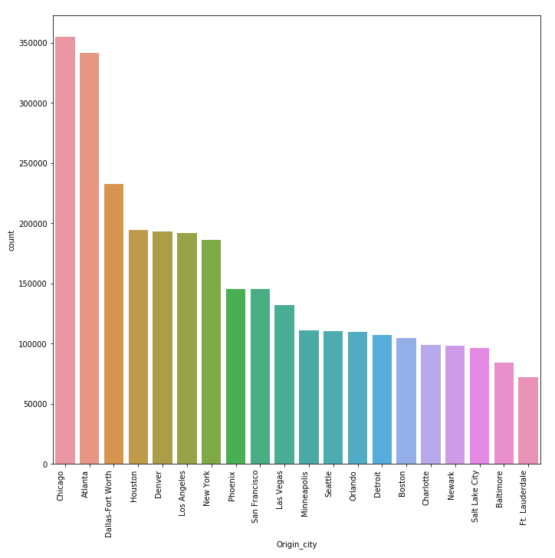
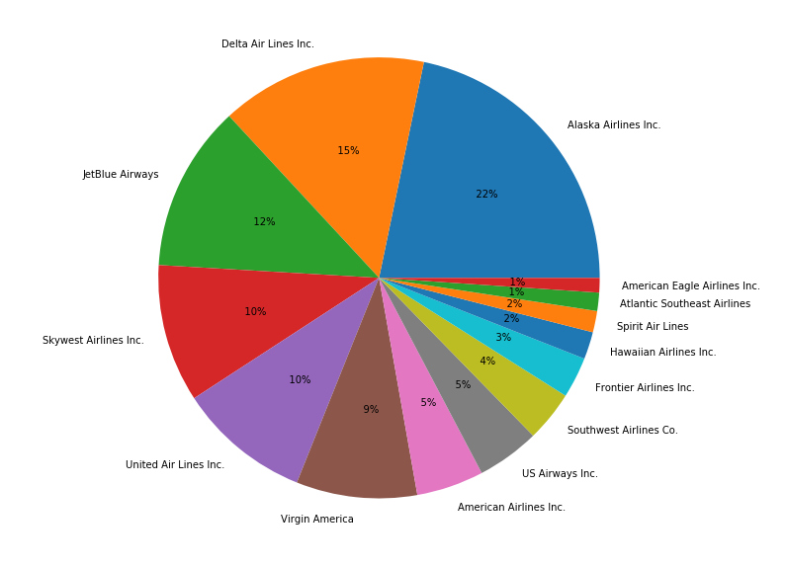
Data Visualization
Notes:
I used these two plots to map the occurrences of airports and airlines in my data
This was mainly so that I could gain context about what types of flights were most prevalent in my data
This helped me understand some context surrounding my conclusion

Slide 6
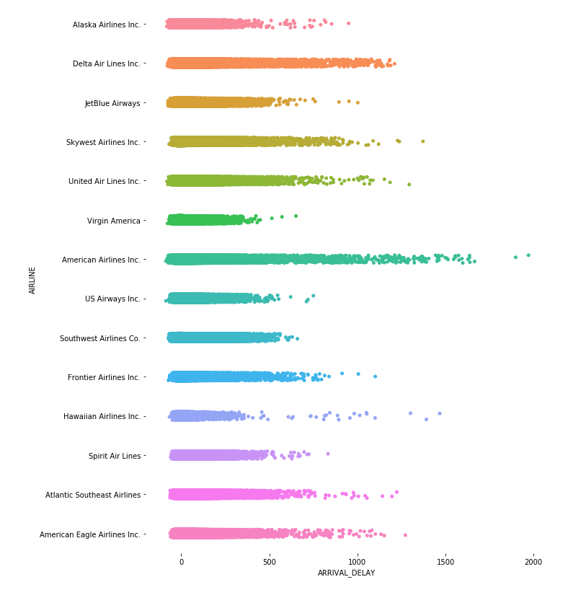
Data Visualization
What airlines had the longest delays?
Notes:
This plot was mostly for fun, I just wanted to see what the distribution of delay times looked like for the airlines present in my data
This graph showed, pretty clearly, that American Airlines was the most notorious for long delays and had the highest number of points out of all airlines in my data

Slide 7
Handling the Data
01
02
03
Deleting the junk
Converting to Float
Normalizing
What factors don’t matter?
What do we do with weird strings?
What stuff matters the most?
Notes:
Based on the exploratory data analysis, I was able to get rid of many factors that did not matter
Unfortunately, I had to get rid of categorical variables such as Airport and Airline since my distance formula (Euclidean) could not handle distance to a category
I then converted all the rows in my data to floats, dropping rows with NaN values along the way
Finally, I normalized and then weighted my data. This allowed me to norm all my values in a spread between -2 and 2

Slide 8
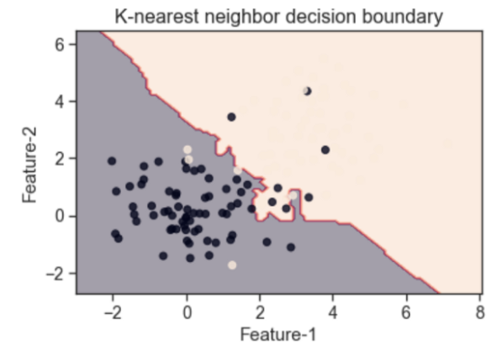
The Results
Visualizing the KNN boundaries
Unweighted Model: 88%
Weighted Model: 92%
Notes:
My models ended up being fairly accurate with around a 90% accuracy rating
This lack of performance could be attributed to not using all the data out of a time constraint
I thought one interesting thing to visualize would be the decision boundary that KNN makes for two features
Since my model was multidimensional, this is not a completely accurate graph – but it is interesting to see where it draws the line
Although not pictured here, the line would also shift given variance in the n_neighbors parameter.

Slide 9
Conclusion
Arrival Time
Airline Delays
Air System Issues
Notes:
This report highlighted a few reasons that a departure delay might occur. Determining effectively that the most important factors in predicting airline delays are the airline that the plane is registered to, air system delays resulting from high airport traffic or emergency situations, and most importantly an arrival delay. The Airline a passenger travels on will determine many aspects of the flight experience. Different access to mechanical repairs, food delivery, staff availability, or airport timings based on Airline could mean entirely different take-off times, even for an identical flight. Air system delays were most prevalent for flights taking off from America’s busiest airports such as Atlanta or Los Angeles. These delays are often due to long taxi times and queues for take-offs, prolonged holds at the gate for maintenance and tug availability, and emergency landings or aborted takeoffs from the airport. Finally, the most impactful factor and most heavily weighted factor in my KNN model is the arrival delay. A flight that arrives late automatically has less time to clean, refuel, and restaff before its next flight

Slide 10
THANK YOU
Please keep this slide for attribution

